Slide 1

JAVA Presentation
Online
Appointment
&
Medicine
Group Members:
1.Aseya Khanom [17-35394-3]
2.Bushra Amana [18-36568-1]
3.Shafin Talukder [18-36588-1]
4.Arshad Hassan Aywon [18-36601-1]

Slide 2
INTRODUCTION

Slide 3
Introduction
Online Doctor Appointment
*See Doctors List and visiting times.
*Confirm Doctor Appointment.
Why this proposal ?
Saving of time, money and energy.
Make the medicine shipping more comfortable.

Slide 4
Some website for online appointment in Bangladesh
E-sastho Seba
Doctorsbd.com
FEELWELL
Square Hospital Limited
Popular hospital Limited
Why you use our system for online doctor appointment?

Slide 5
Introduction
Online Medicine:
*Local
*Foreign
#Order Unavailable Medicines
Why this proposal ?
To save energy and time.
Take the appointment system at a high stage.

Slide 6
Some website for online medicine
ONLINE PHARMACY INDIA
TRUST PHARMACY
DRUGS.com
NHS PHARMACY UK
Why you use our system for online medicine purpose?

Slide 7
Tools Used:
NetBeans
Xampp
JDBC Connector
OOP and Java Concepts Used:
Inheritance.
Interface.
Exception Handling.
Graphical User Interface.
Java Database Connectivity.
Events.
Array List.

Slide 8
DIAGRAMS

Slide 9
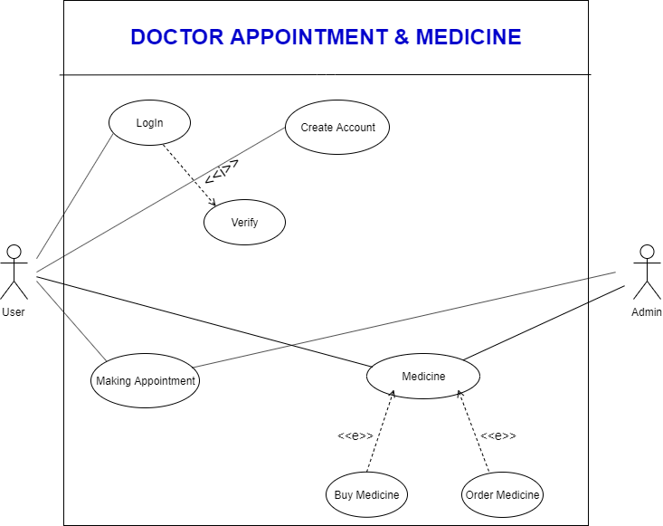
Use Case

Slide 10
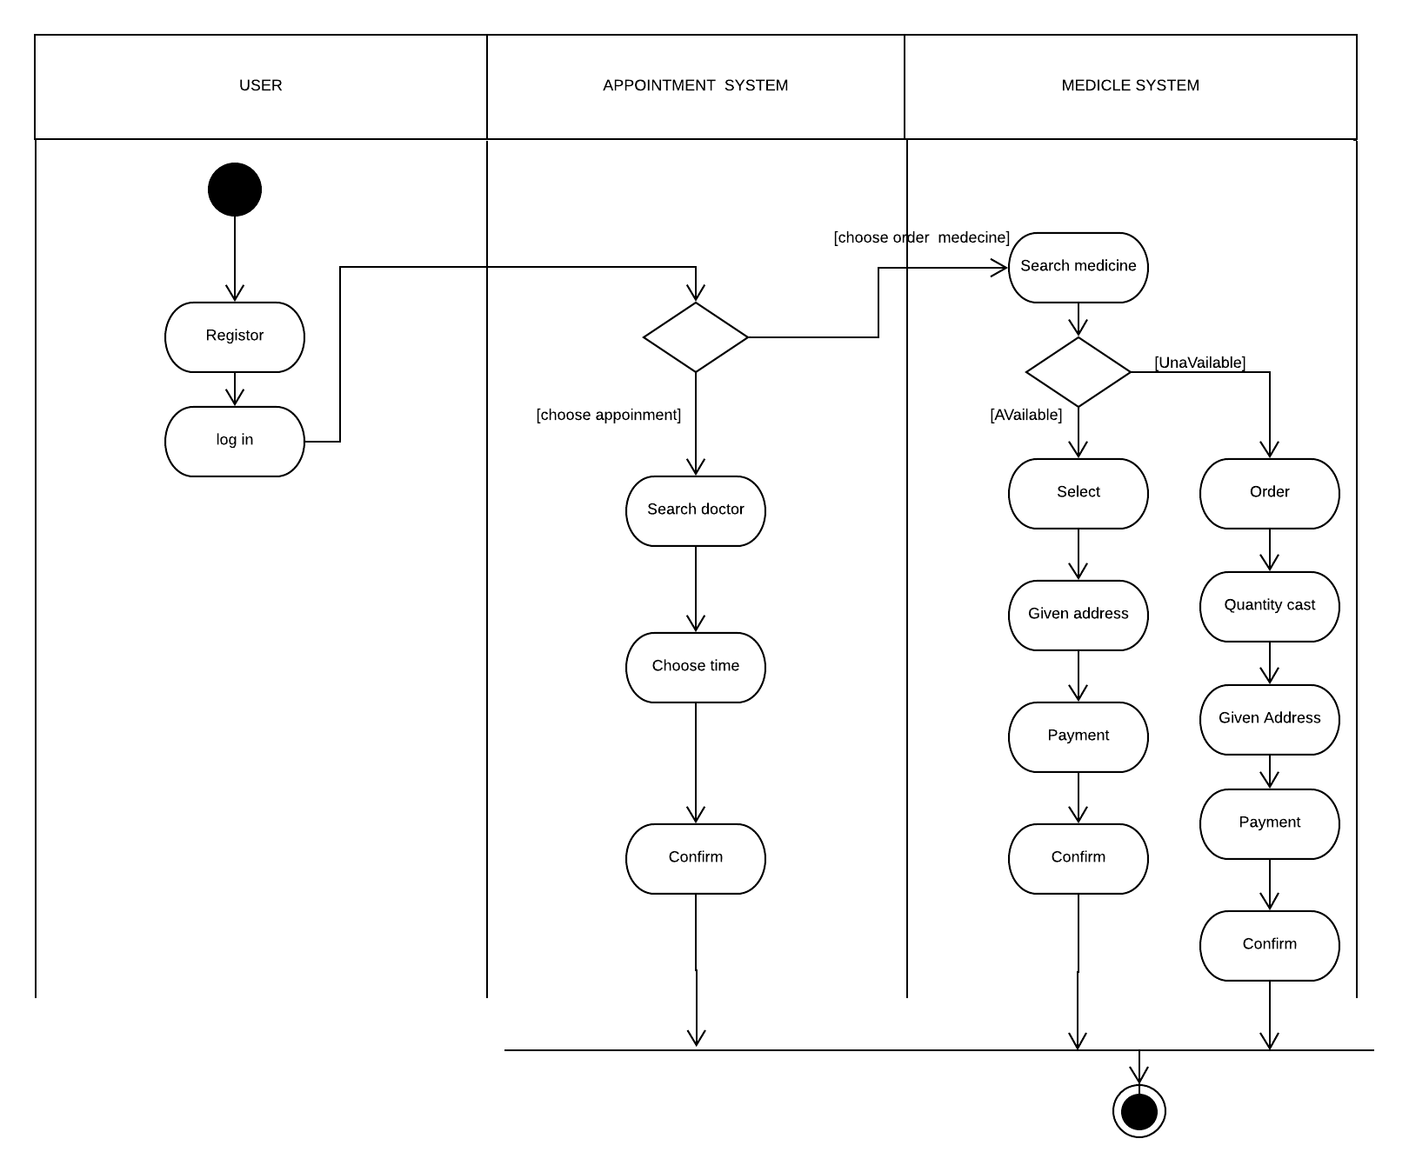
Activity Diagram

Slide 11
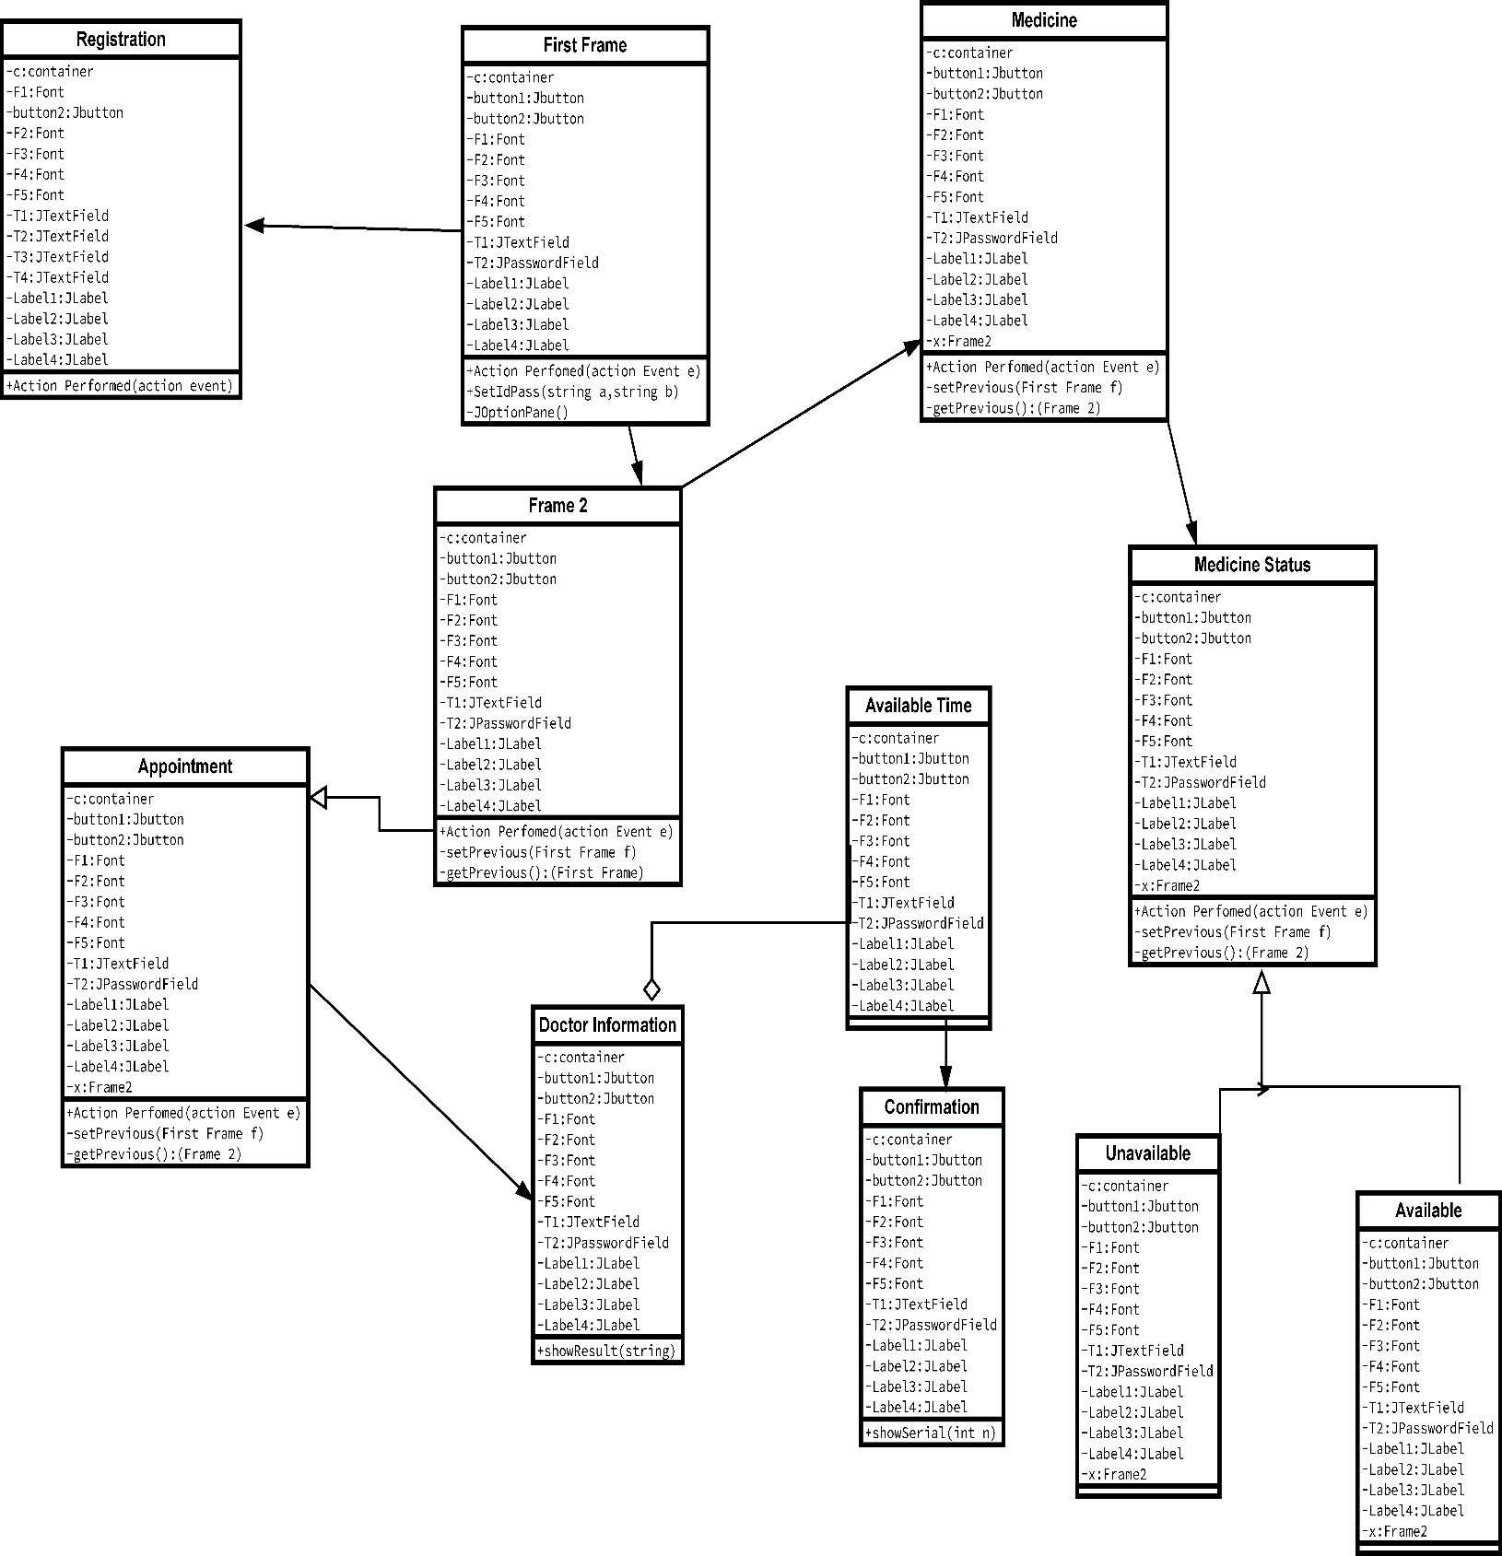
Class Diagram

Slide 12
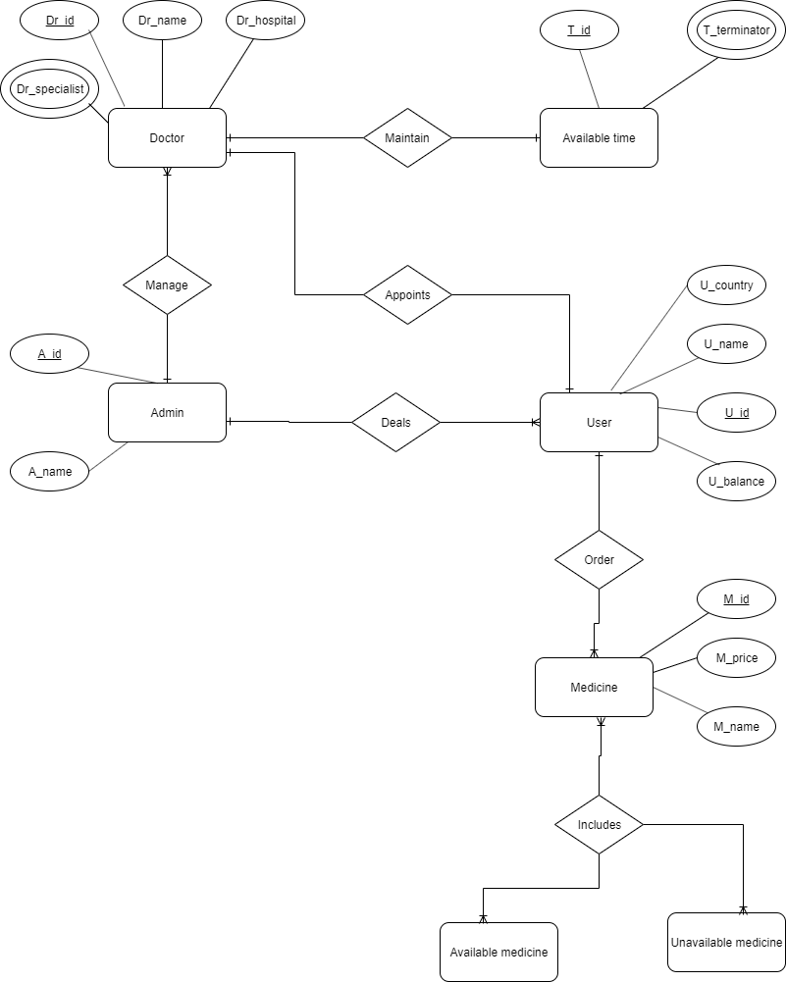
ER Diagram

Slide 13
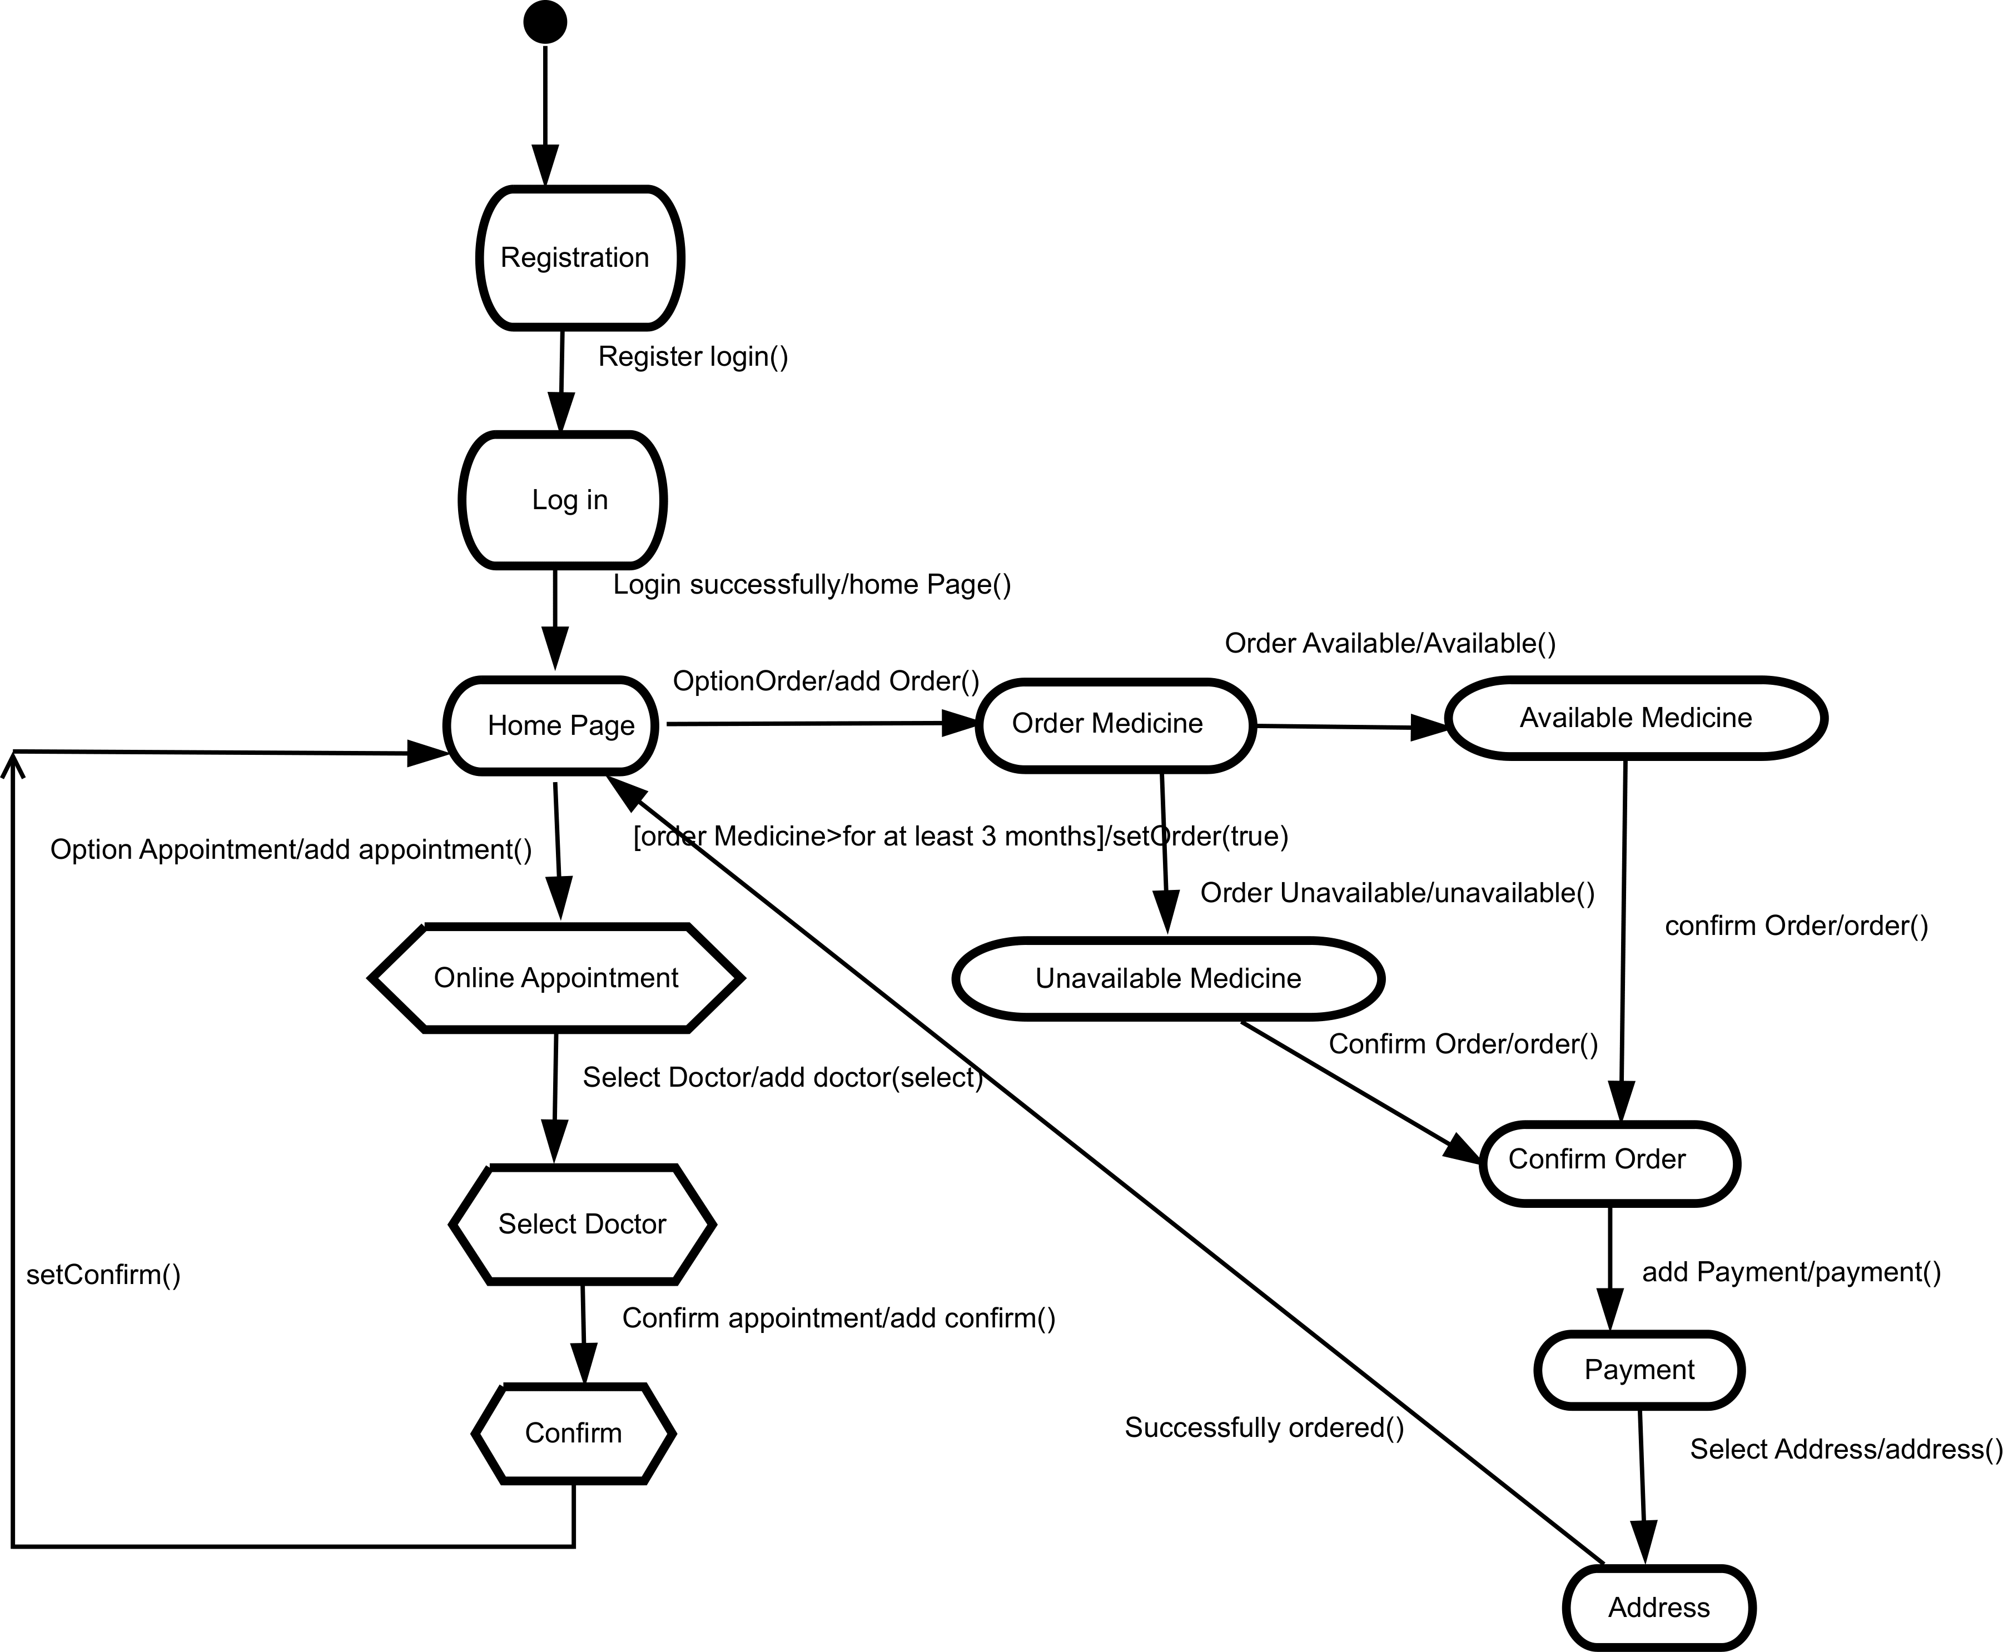
State Chart Diagram

Slide 14
Working
Process

Slide 15
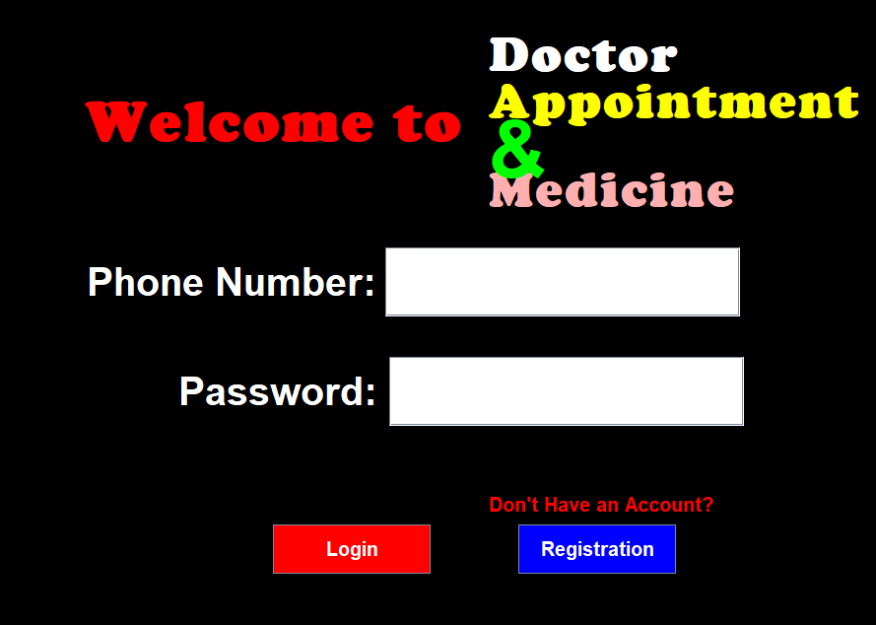

Slide 16
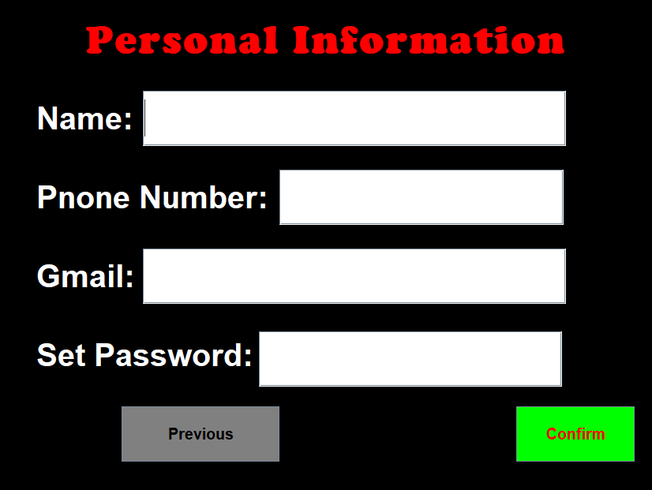

Slide 17
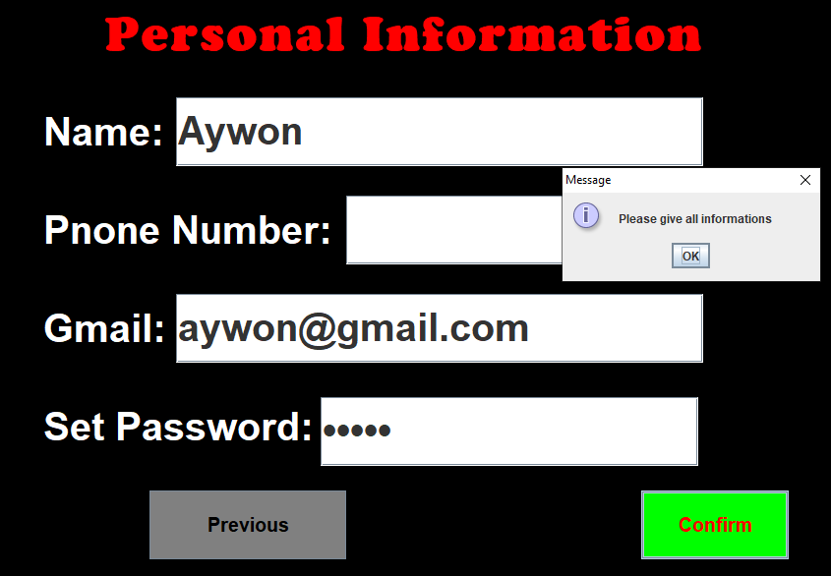

Slide 18
017********

Slide 19
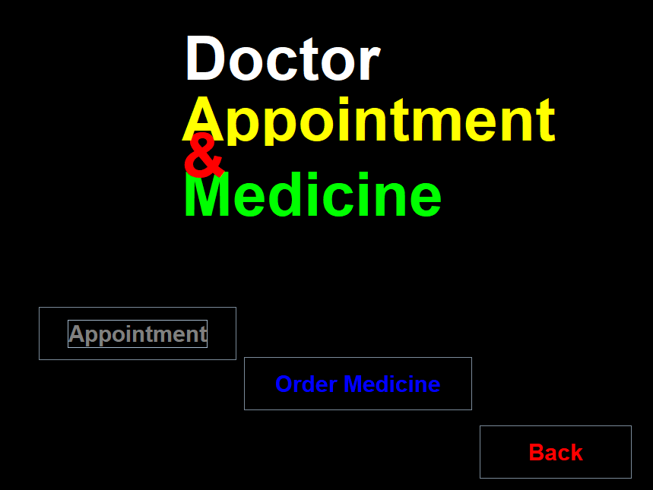

Slide 20
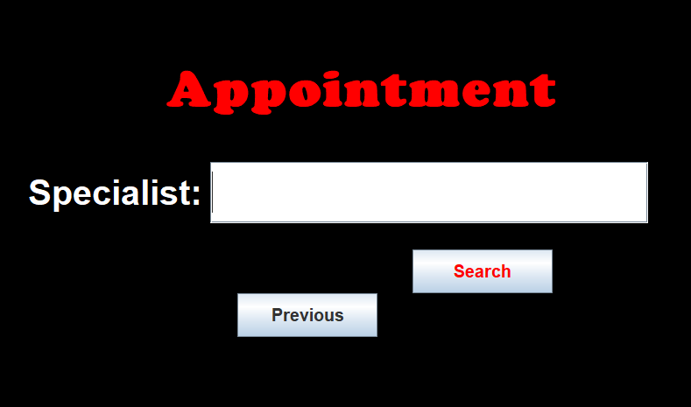
Cancer

Slide 21
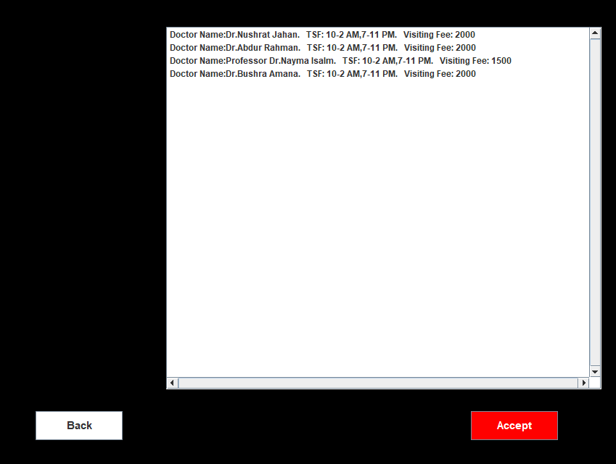

4

Slide 22
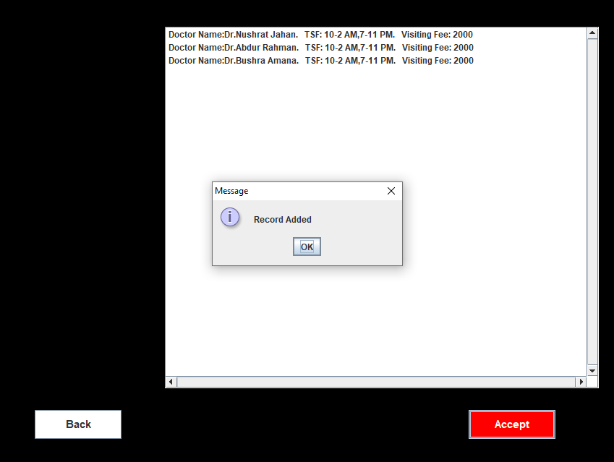
3

Slide 24
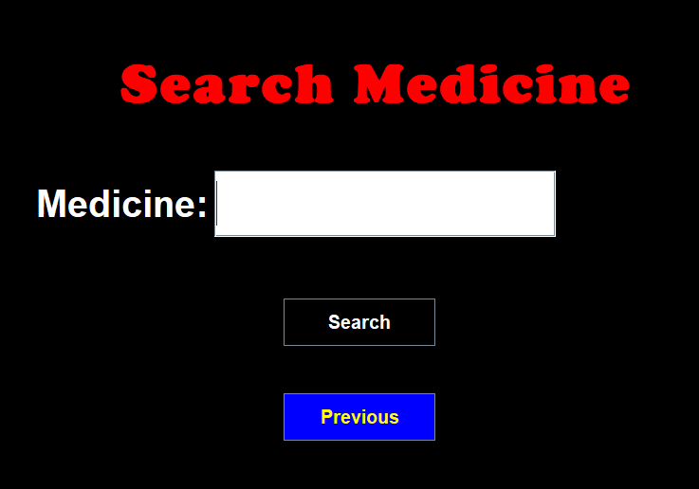
Biseptol

Slide 25
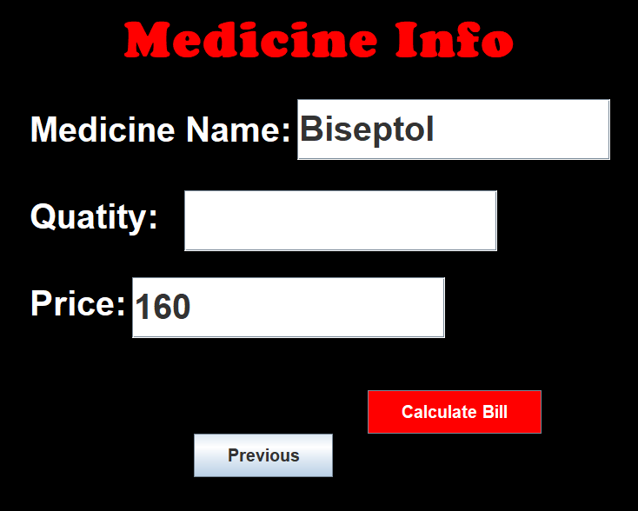
10

Slide 26
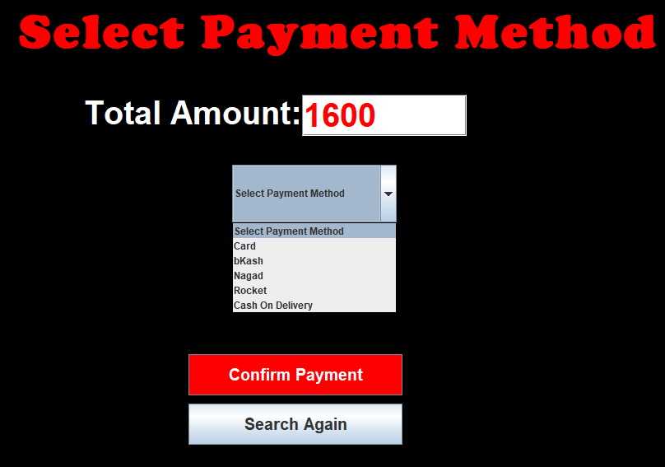

Slide 27
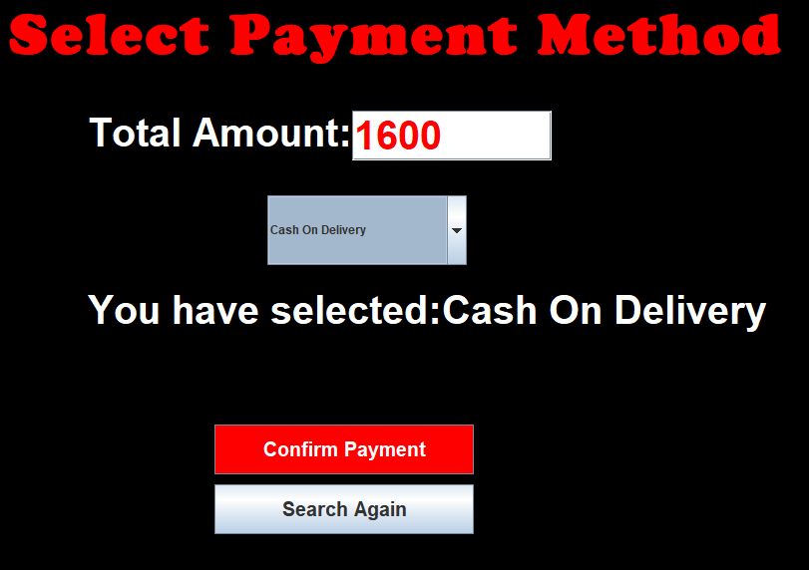

Slide 28
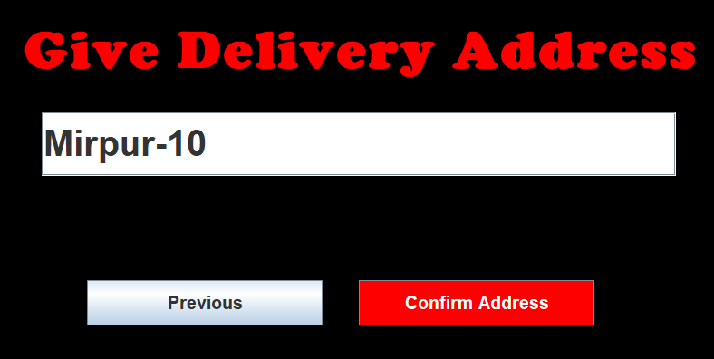

Slide 29
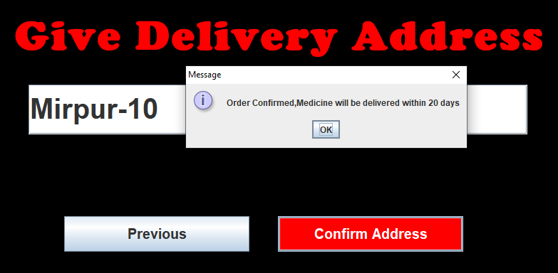

Slide 31
CONCLUSION

Slide 32
Impacts:
Save time.
Save Money.
Save Energy.
Easily order medicine.
Confirm any Appointment easily.

Slide 33
Limitations
Accessible for Inner Dhaka.
May take long delivery time.
Not fully user-friendly.
Internet.
Page flexibility.

Slide 34
Possible Future Improvements
Useable for whole country.
Make fully user-friendly.
Adding more medicines.
Online reports.
Reduce delivery date.
Doctor Feedback.
Show suggestions via feedback.

Slide 35


Slide 36



